Slide 1
Geometry and Area

Slide 2
SURFACE AREA AND VOLUME
Introduction
Introduction to types of angles and questions based on angles
Difference between incircle and circumcircle and their radii

Slide 3
SOME IMPORTANT ANGLES
Complementary angles:
Two angles whose sum is 90 degree are called Complementary Angles.
For example 40 degree and 50 degree
Their sum =40 degree +50 degree= 90 degree
Supplementary angles:
Two angles whose sum is 180 degree are called Supplementary Angles. For example 100 degree and 80 degree
Their sum =100 degree + 80 degree= 180 degree
Linear pairs:
Two angles on a given line are called linear if their sum is 180 degree.
Vertically opposite angles:
Vertically opposite angles are formed when two lines, say AB and CD intersect each other at a point O. There are two pairs of vertically opposite angles and they are always equal

Slide 4
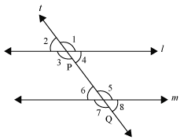
Transversal: A line which intersects two or more lines at different points is called a transversal.
1) Corresponding angles:
i) Angle 1 and Angle 5
ii) Angle 2 and Angle 6
iii) Angle 4 and Angle 8
iv) Angle 3 and Angle 7
2) Alternate interior angles
i) Angle 4 and Angle 6
ii) Angle 3 and Angle 5
3) Alternate exterior angles
i) Angle 1 and Angle 7
ii) Angle 2 and Angle 8
4) Interior angles on the same side of the transversal
i) Angle 4 and Angle 5
ii) Angle 3 and Angle 6

Slide 5
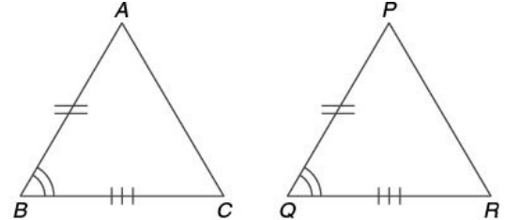
Congruency of Triangles
Two triangles are congruent if all the sides of one are equal to the corresponding sides of another. It follows that all the angles of one are equal to the corresponding angles of another. The notation for congruency is ≅
Conditions of Congruency in Triangles
SAS congruency: If two sides and an included angle of one triangle are equal to two sides and an included angle of another, the two triangles are congruent. Here, AB = PQ, BC = QR, and ∠B = ∠Q ; So △ABC ≅ △PQR

Slide 6
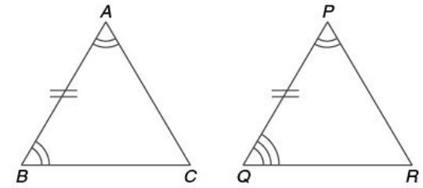
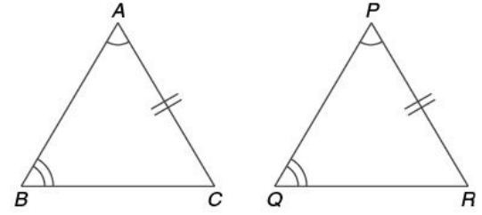
ASA congruency: If two angles and the included side of one triangle is equal to two angles and the included side of another, the triangles are congruent. (See figure below.) Here, ∠A = ∠P, ∠B = ∠Q and AB = PQ , So △ABC ≅ △PQR
AAS congruency: If two angles and side opposite to one of the angles is equal to the corresponding angles and the side of another triangle, the triangles are congruent. ∠A = ∠P; ∠B = ∠Q; and AC = PR; So △ABC ≅ △PQR

Slide 7
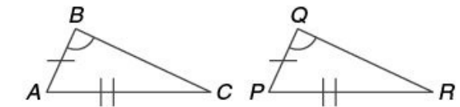
SSA congruency: If two sides and the angle opposite the greater side of one triangle are equal to the two sides and the angle opposite to the greater side of another triangle, then the triangles are congruent. The congruency doesn’t hold if the equal angles lie opposite the shorter side. If
AB = PQ; AC = PR; ∠B = ∠Q;
Then the triangles are congruent. i.e.
△ABC ≅△PQR
Basic Pythagorean Triplets
(3, 4, 5) ; (5, 12, 13) ; (7, 24, 25) ; (8, 15, 17) ; (9, 40, 41); (11, 60, 61) ; (12, 35, 37) ; (16, 63, 65) ; (20, 21, 29) ; (28, 45, 53)

Slide 8
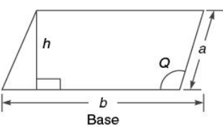
Types of quadrilaterals
Parallelogram (ll gm)
A parallelogram is a quadrilateral with opposite sides parallel
(as shown in the figure below.)
Area = Base (b) × Height (h)
Area = product of any two adjacent sides × sine of the included angle = ab sin Q
Perimeter = 2 (a + b) where a and b are any two adjacent sides
Diagonals of a parallelogram bisect each other.
Bisectors of the angles of a parallelogram form a rectangle.
A parallelogram inscribed in a circle is a rectangle.
A parallelogram circumscribed about a circle is a rhombus.
The opposite angles in a parallelogram are equal.
The sum of the squares of the diagonals is equal to the sum of the squares of the four sides in the figure: AC² + BD² = 2(AB² + BC²).

Slide 9
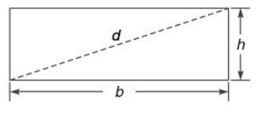
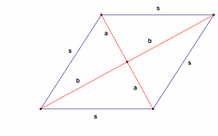
Base and height are also referred to as the length and the breadth in a rectangle.
Diagonal (d) =
Rectangles
A rectangle is a parallelogram with all angles 90°
Area = Base × Height = b × h
Base and height are also referred to as the length and the breadth in a rectangle.
Diagonal (d) = by Pythagoras theorem
Diagonals are equal and bisect each other
Bisectors of the angles of a rectangle (a parallelogram) form another rectangle.
All rectangles are parallelograms but the reverse is not true.
Rhombus
A parallelogram having all the sides equal is a rhombus
Area = 1/2 × product of diagonals × sine of the angle between them = (d₁ * d₂)/2
(Diagonals in a rhombus intersect at right angles)
Area = product of adjacent sides × sine of the angle between them.
Diagonals bisect each other at right angles.
All rhombuses are parallelograms but the reverse is not true
A rhombus may or may not be a square but all squares are rhombuses.

Slide 10
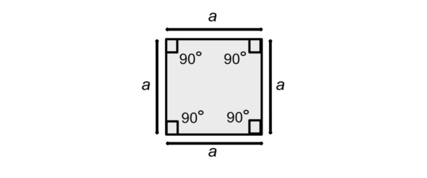
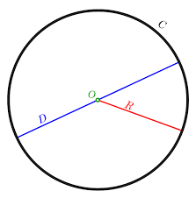
Square
A square is a rectangle with adjacent sides equal or a rhombus with each angle 90°
Area = base × height = a2
Area = 1/2 (diagonal)2 = 1/2 d2 (square is a rhombus too)
Perimeter = 4a (a = side of the square)
Diagonal =
Radius = a/2
Circles
Area = pi * r2
Circumference = 2 pi * r = (r = radius)
Area = 1/2 × circumference × r. Arc: It is a part of the circumference of the circle. The bigger one is called the major arc and the smaller one the minor arc.
Length (Arc XY) =

Slide 11
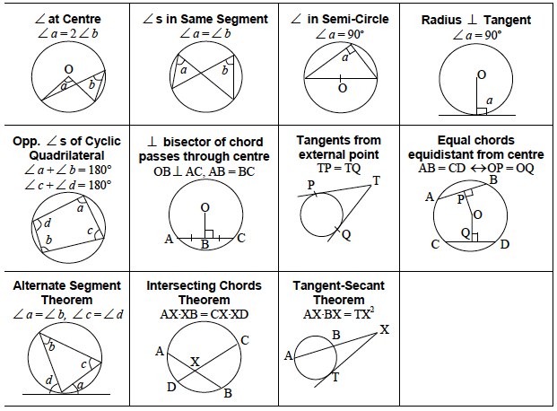
Properties of a circle
.

Slide 12
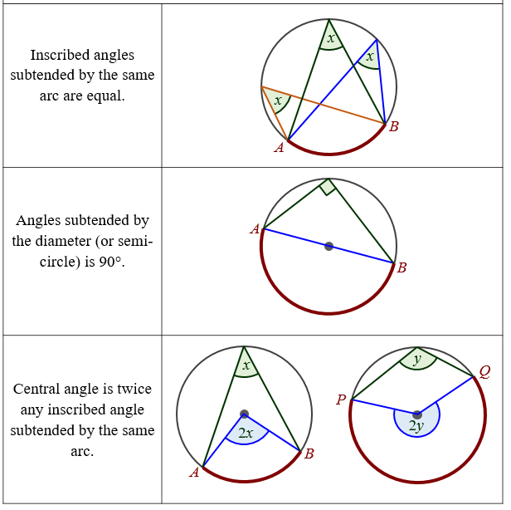

Slide 13
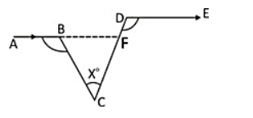
Q 1 In the adjoining figure, ∠ABC = 100°, ∠EDC = 120° and AB || DE. Then, ∠BCD is equal to ? a) 45° b) 35° c) 50° d) 40°
Notes:
Option d is correct
Easy (Compulsory)

Slide 14
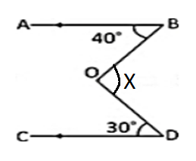
Q 2 In the given figure, AB || CD, ∠ABO = 40° and ∠CDO = 30°. If ∠DOB = x°, then the value of x is ? a) 50° b) 60° c)80° d)70°
Notes:
Option d is correct
Easy (Compulsory)

Slide 15
Q 4 In a triangle ABC, the side BC is extended up to D. Such that CD = AC, if angle BAD = 110° and angle ACB= 70° then the value of angle ABC is ? a) 35° b) 26° c)18° d) 40°
Notes:
Option a is correct
Moderate (Compulsory)

Slide 16
Q 6 In a triangle ABC , AB=AC , ∟BAC = 40° , then the external angle at B is ? a) 80° b)70° c) 110° d)90°
Notes:
Option c is correct
Easy (Optional)

Slide 17
Q 7 The sum of the measures of the angles of regular polygon is 2160°. How many sides does it have? a) 10 b) 12 c) 14 d) 16
Notes:
Option c is correct
Easy (optional)

Slide 18
Q 8 External angle of a regular polygon is 72°. Find the sum of all the interior angles of it ? a) ) 360° b)720° c) 540° d)648°
Notes:
Option c is correct
Easy (Compulsory)

Slide 19
Q 11 In a || gm, the adjacent sides are 36 cm and 27 cm in length. If the distance between the longer sides is 12 cm, then the distance between the smaller sides is : (a) 12 cm (b) 16 cm (c) 14 cm (d) 15 cm
Notes:
Option b is correct
Moderate (Compulsory)

Slide 20
Q 12 The length of a side of a rhombus is 13 cm and one of its diagonal is 24 cm. The length of the other diagonal is: (a) 14 cm (b) 12 cm (c) 20 cm (d) 10 cm
Notes:
Option d is correct
Easy (optional)

Slide 21
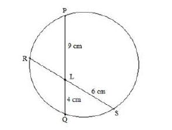
Q 13 In the given figure , PQ and RS intersects at point L. Find the length of RL? a) 8 cm b) 2 cm c) 3 cm d) 6 cm
Notes:
Option d is correct
Moderate (Compulsory)

Slide 22
Q 14 Two concentric circles are of radii 13 cm and 5 cm . The length of the chord of the larger circle which touches the smaller circle is ? a) 24 cm b) 15 cm c) 13 cm d) 18 cm
Notes:
Option a is correct
Moderate (Compulsory)

Slide 23
Q 16 XYZ is a triangle. If the medians ZL and YM intersects each other at point G . Then find the ratio of (area of triangle GLM : area of the triangle XYZ ) a) 1:14 b) 1:12 c) 1:11 d) 1:13
Notes:
Option b is correct
Easy (optional)

Slide 24
Q 17 If the three sides of a triangle are 11 cm , 12 cm, and 13 cm ,then what is the area of the given triangle ( in cm²) ?
a) (15√13) b) (13√26) c)(6√105) d) (17√42)
Notes:
Option c is correct
Easy (Compulsory)

Slide 25
Q 18 A room 5 m 44 cm long and 3 m 74 cm broad is to be paved with square tiles. Find the least number of square tiles required to cover the floor. a)120 b) 176 c) 200 d) 198
Notes:
Option b is correct
Moderate (Compulsory)

Slide 26
Q 19 The perimeters of two squares are 40 cm and 32 cm. Find the perimeter of a third square whose area is equal to the difference of the areas of the two squares. a) 4 cm b) 8 cm c) 24 cm d) 20 cm
Notes:
Option c is correct
Moderate (optional)

Slide 27
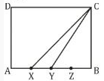
Q 20 Side AB of rectangle of ABCD is divided into four equal parts by points x, y, z. The ratio of the (area (∆XYC))/(Area (Rectangle ABCD)) is : (a) 1/7 (b) 1/6 (c) 1/9 (d) 1/8
Notes:
Option d is correct
Expert (Compulsory)

Slide 28
Q 21 The diagonal of rectangle is 15 cm and length is 12 cm . Find the area of the rectangle ? a) 108cm² b) 116 cm² c) 114 cm² d) 112 cm²
Notes:
Option a is correct
Easy (Optional)

Slide 29
Q 23 The area of rectangle is equal to the area of a circle whose radius is 14 cm. If the breadth of the rectangle is 22 cm, what is its length? a) 28 cm b) 25 cm c) 30 cm d) 35 cm
Notes:
Option a is correct
Moderate (Compulsory)

Slide 30
Q 27 What is the radius of the circle whose area is equal to the sum of the areas of two circles whose radius are 15 cm and 8 cm ? a) 14 cm b) 15 cm c) 17 cm d) 13 cm
Notes:
Option c is correct
Moderate (Optional)

Slide 31
Q 28 If the circumcenter of a triangle lies outside the triangle then the triangle is ? a) Equilateral b)Acute angle c)Right angled d)Obtuse angled
Notes:
Option d is correct
Easy (Compulsory)

Slide 32
Q 29 The length of the two sides forming the right angle of a right angled triangle are 6 cm and 8 cm . The length of its circumradius is ? a) 5 cm b) 7 cm c) 6 cm d) 10 cm
Notes:
Option a is correct
Moderate (Compulsory)

Slide 33
Q 30 The length of the two sides forming the right angled triangle are 21 cm and 20 cm . What will be the radius of the circle circumscribing the triangle ? a) 14.5 cm b) 14 cm c) 12 cm d) 15.5 cm
Notes:
Option a is correct
Moderate (Compulsory)

Slide 34
TRUE and BANKER’S DISCOUNT

Slide 35
Directions
True and Banker Discount
True and Banker Discount
Revision of concept of SI and CI, Relating SI and CI concept with TD and BD
Banker's gain, Present worth (PW)
DS on based topic

Slide 36
Directions
True and Banker Discount
True Discount and Banker's Discount Concepts
Present Value:
The money to be paid before the due date to clear off debt is called present worth.
True Discount:
The difference between the amount due and the present value or worth of the amount is called the true discount. In other words, it is the interest on the present worth.
Banker's Discount:
It is the simple interest on the face value or amount due for the period from the date on which the bill was discounted till the legally due date or for the unexpired time.
Banker’s gain:
The interest on the bill value (face value) is called the banker's discount and the difference between the banker's discount and true discount (T.D) is called banker's gain (B.G).
Banker's gain = Banker's discount - True discount

Slide 37
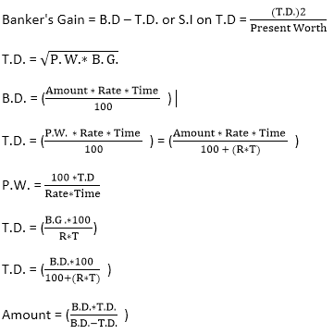
Formulae:

Slide 38
Directions
True and Banker Discount
Q1. If the true discount on a sum due 8 years hence at 10% per annum be Rs 560, the sum due is:
a) 1260 b) 1400 c) 1520 d) 1900
Notes:
Correct Option: A
Easy (Compulsory)

Slide 39
Directions
True and Banker Discount
Q2. The true discount on Rs 6864 due 6 months hence is 264. The rate percent is:
a) 8% b) 12% c) 15% d) 20%
Notes:
Correct Option: B
Easy (Compulsory)

Slide 40
Directions
True and Banker Discount
Q3. The true discount on Rs 2420 due after a certain time at 20 % per annum is Rs 220. The time after which it is due is:
a) 6 months b) 8 months c) 10 months d) 12 months
Notes:
Correct Option: A
Easy (Compulsory)

Slide 41
Directions
True and Banker Discount
Q4. The true discount on a bill due 6 months hence at 20% per annum is Rs 731. The amount of the bill is:
a) 7581 b) 7957 c) 8041 d) 8129
Notes:
Correct Option: C
Easy (Optional)

Slide 42
Directions
True and Banker Discount
Q5. The interest on Rs. 1000 for 2 years is the same as the true discount on Rs. 1280 due 2 years hence. If the rate of interest is the same in both cases , it is:
a) 10% b) 12% c) 14% d) 16%
Notes:
Correct option: C
Moderate (Compulsory)

Slide 43
True and Banker Discount
Q6. A has to pay Rs. 220 to B after 1 year. B asks A to pay Rs. 110 in cash and defer the payment of Rs. 110 for 2 years. A agrees to it. If the rate of interest be 10% per annum in this mode of payment:
a) There is no gain or loss to anyone b) A gains Rs. 7.34
c) A loses Rs 7.34 d) A gains Rs. 11
Notes:
Option B
Expert (Compulsory)

Slide 44
Directions
True and Banker Discount
Q7. The true discount on a bill of Rs 600 is Rs 100. The banker’s discount is:
a) 120 b) 180 c) 200 d) 220
Notes:
Option: A
Easy (Optional)

Slide 45
Directions
True and Banker Discount
Q8. The present worth of a certain bill due sometimes hence is Rs 600 and the true discount is Rs 24. The banker’s discount is:
a) 24 b) 24.96 c) 24.38 d) 28.98
Notes:
Correct Option: B
Easy (Optional)

Slide 46
Directions
True and Banker Discount
Q9. A trader owes a merchant Rs. 10573 due 1 year hence. The trader wants to settle the account after 3 months. If the rate of interest is 12% per annum, how much cash should he pay?
a) 8700 b) 9000 c) 9700 d) 10500
Notes:
Correct option: C
Moderate (Optional)

Slide 47
True and Banker Discount
Q10. The present worth of Rs. 2610 due 3 years hence, the rate of interest being 15% per annum is :
a) 1650 b) 1680 c) 1760 d) 1800
Notes:
Correct option: D
Easy (Compulsory)

Slide 48
Directions
True and Banker Discount
Q11. The present worth of Rs. 2960 due 4 years hence, the rate of interest being 12% per annum will be :
a) 1000 b) 1500 c) 2000 d) 2500
Notes:
Correct Option: C
Easy (Optional)

Slide 49
True and Banker Discount
Directions
Q12. The banker’s gain on a certain sum due 5/2 years hence is 5/27 of the banker’s discount. The rate percent is:
a) 100/11% b) 10% c) 25% d) 100/3%
Notes:
Correct Option: A
Moderate (Compulsory)

Slide 50
Directions
True and Banker Discount
Q13. The banker’s gain on a certain sum due 5/2 years hence is 5/23 of the banker’s discount. The rate percent is:
a) 100/9% b) 15% c) 100/3% d)50%
Notes:
Correct Option: A
Moderate (Optional)

Slide 51
Directions
True and Banker Discount
Q14. The banker’s discount on Rs. 1600 at 15% per annum is the same as true discount on Rs. 1680 for the same time and at the same rate. The time is:
a) 3 months b) 4 months c) 5 months d) 6 months
Notes:
Option B
Moderate (Compulsory)

Slide 52
Directions
True and Banker Discount
Q15. A bill of Rs. 6000 is drawn on July 14 at 5 months. It is discounted on 5th October at 10%. Find the banker’s discount and the money that the holder of the bill receives.
Rs.9 and Rs. 5800 b) Rs. 10 and Rs. 5880 c) Rs. 10 and Rs. 5800
d) Rs. 9 and Rs. 5880
Notes:
Option D
Moderate (Compulsory)

Slide 53
Q 16 What is the area of circle O? 1. The circumference is 12π. 2. The diameter is 12. A. Statement (1) alone is sufficient, but statement (2) alone is not sufficient. B. Statement (2) alone is sufficient, but statement (1) alone is not sufficient. C. Both statements (1) and (2) together are sufficient, but neither statement alone is sufficient. D. Each statement alone is sufficient. E. Statements (1) and (2) together are not sufficient.
Notes:
Option d is correct
Easy (Compulsory)

Slide 54
Q 17 What is the diameter of the circle ? I) The circumference is 132 II) radius is 21. (A)If the data in statement I alone is sufficient to answer the question. (B) If the data in statement II alone is sufficient to answer the question. (C) If the data either in statement I alone or statement II alone are sufficient to answer the question. (D) If the data given in both I and II together are not sufficient to answer the question. (E) If the data in both the statements I and II together are necessary to answer the question.
Notes:
Option c is correct
Easy (Optional)

Slide 55
Directions
True and Banker Discount
Q18. Find Banker’s gain if
(i) True discount is Rs. 980 and
(ii) rate of interest is 5% per annum for 4 years
only first statement is sufficient
b) only second statement is sufficient
c) both the statements are required to get the answer
d) either first or second statement is sufficient
e) none of the is statements is sufficient
Notes:
Option C
Easy (Compulsory)

Slide 56
Any Doubts???

